Slide 1
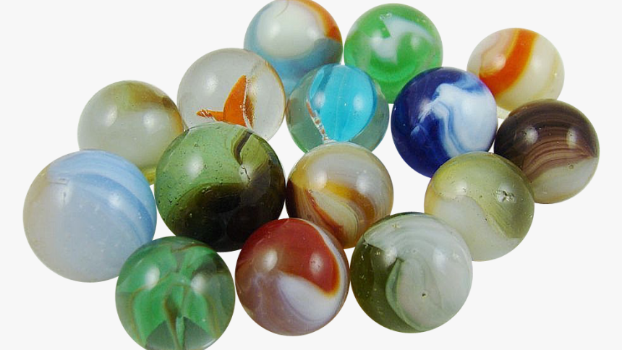
Art Bible
Marble Game: Highs and Lows

Slide 2
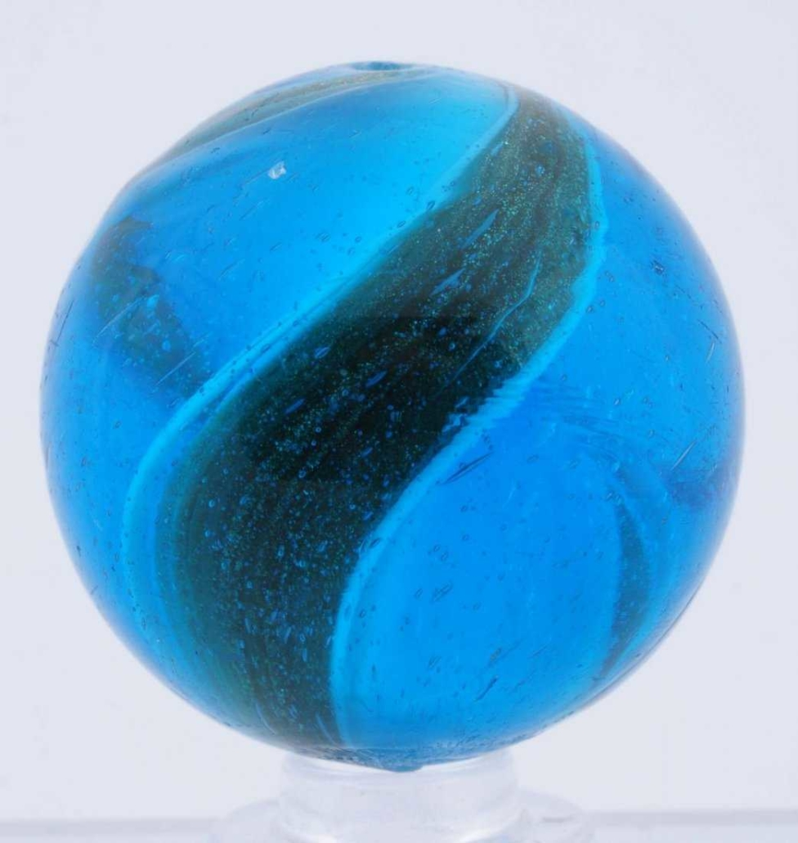
Project Overview
The player must roll the marble through the pipes and ramps to reach the rocket.
The level will involve multiple paths made up of slides and ramps, like a marble run.
NOTE: There are no characters in this game

Slide 3
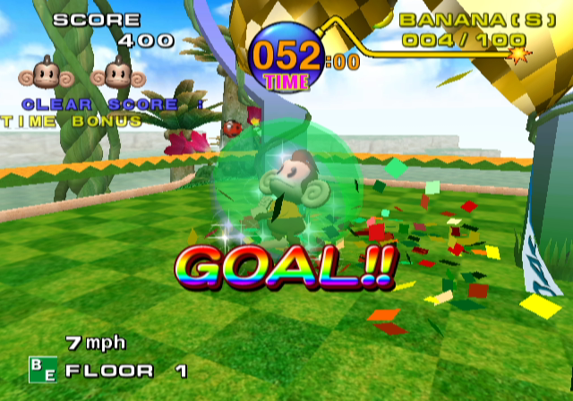
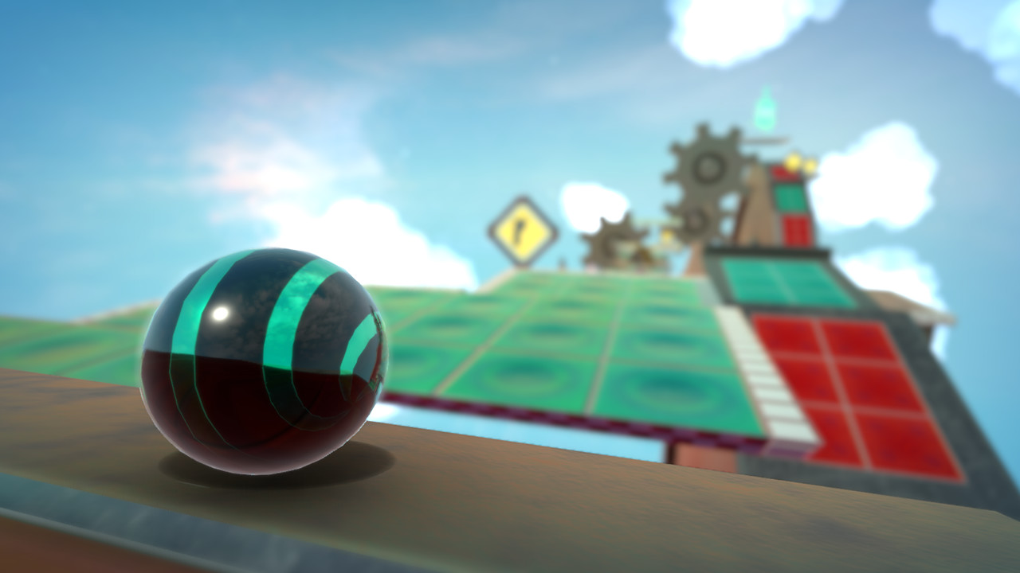
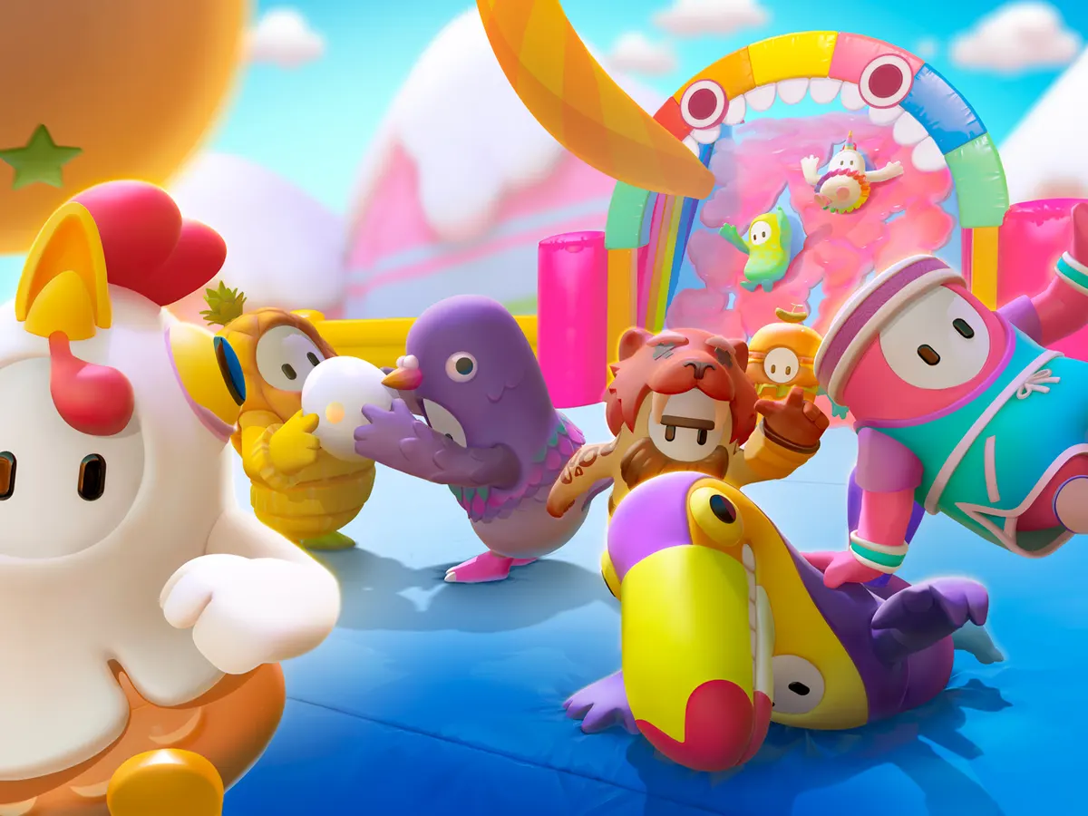
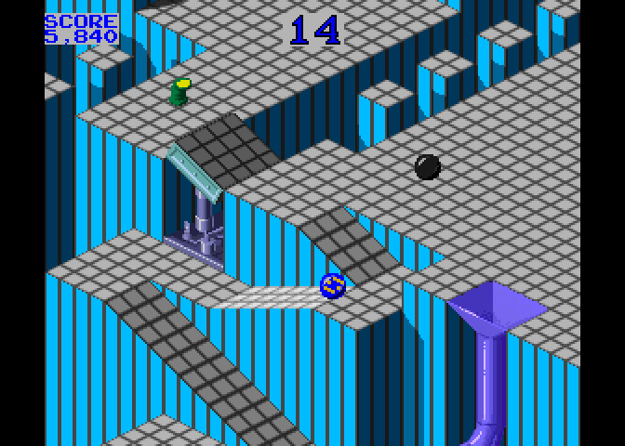
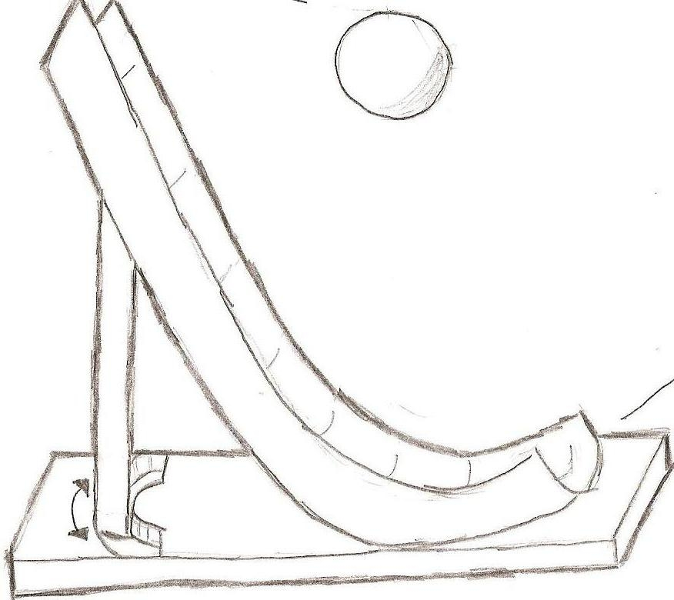
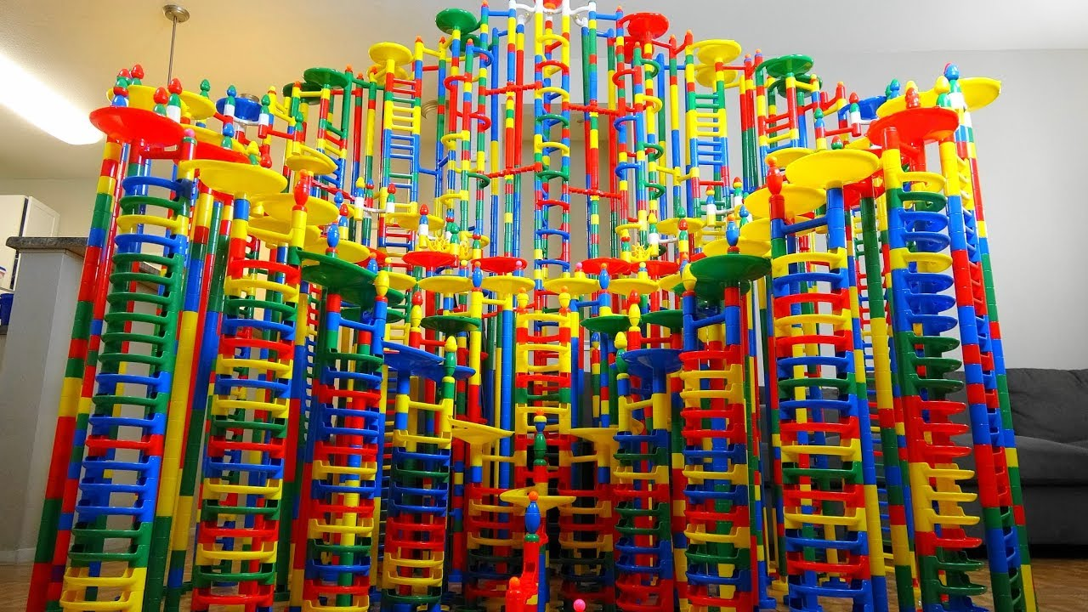
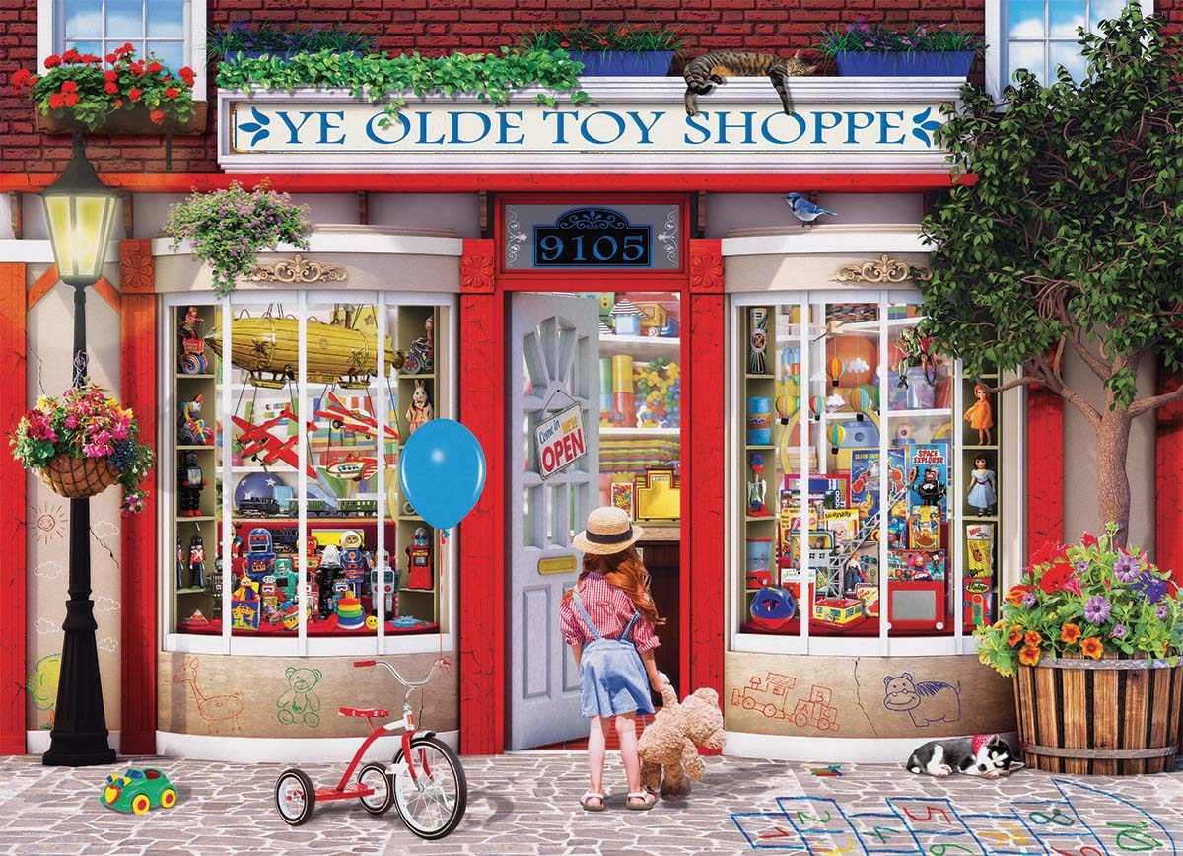
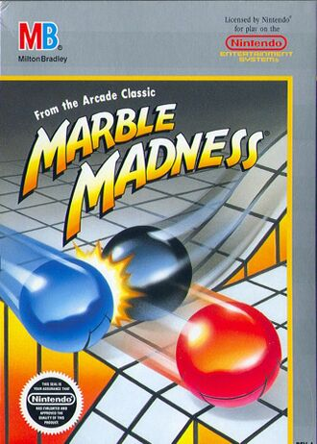
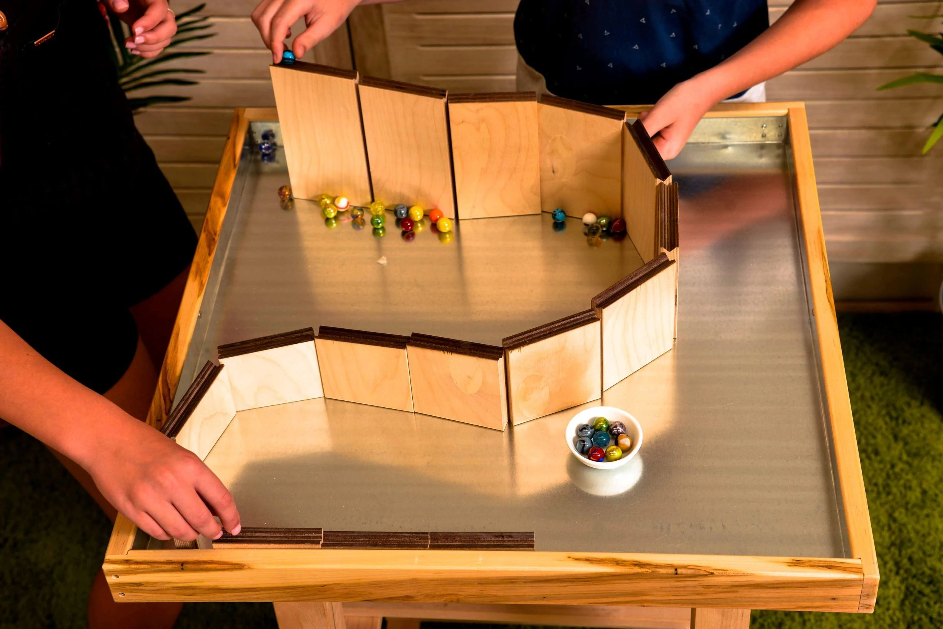
Reference / mood board

Slide 4
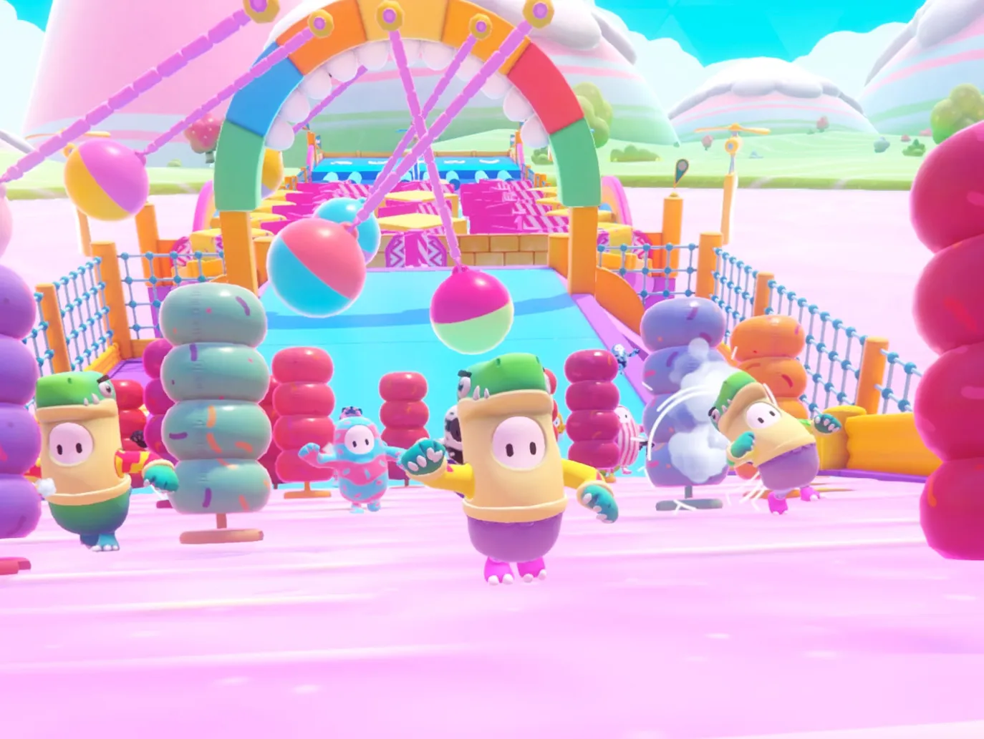
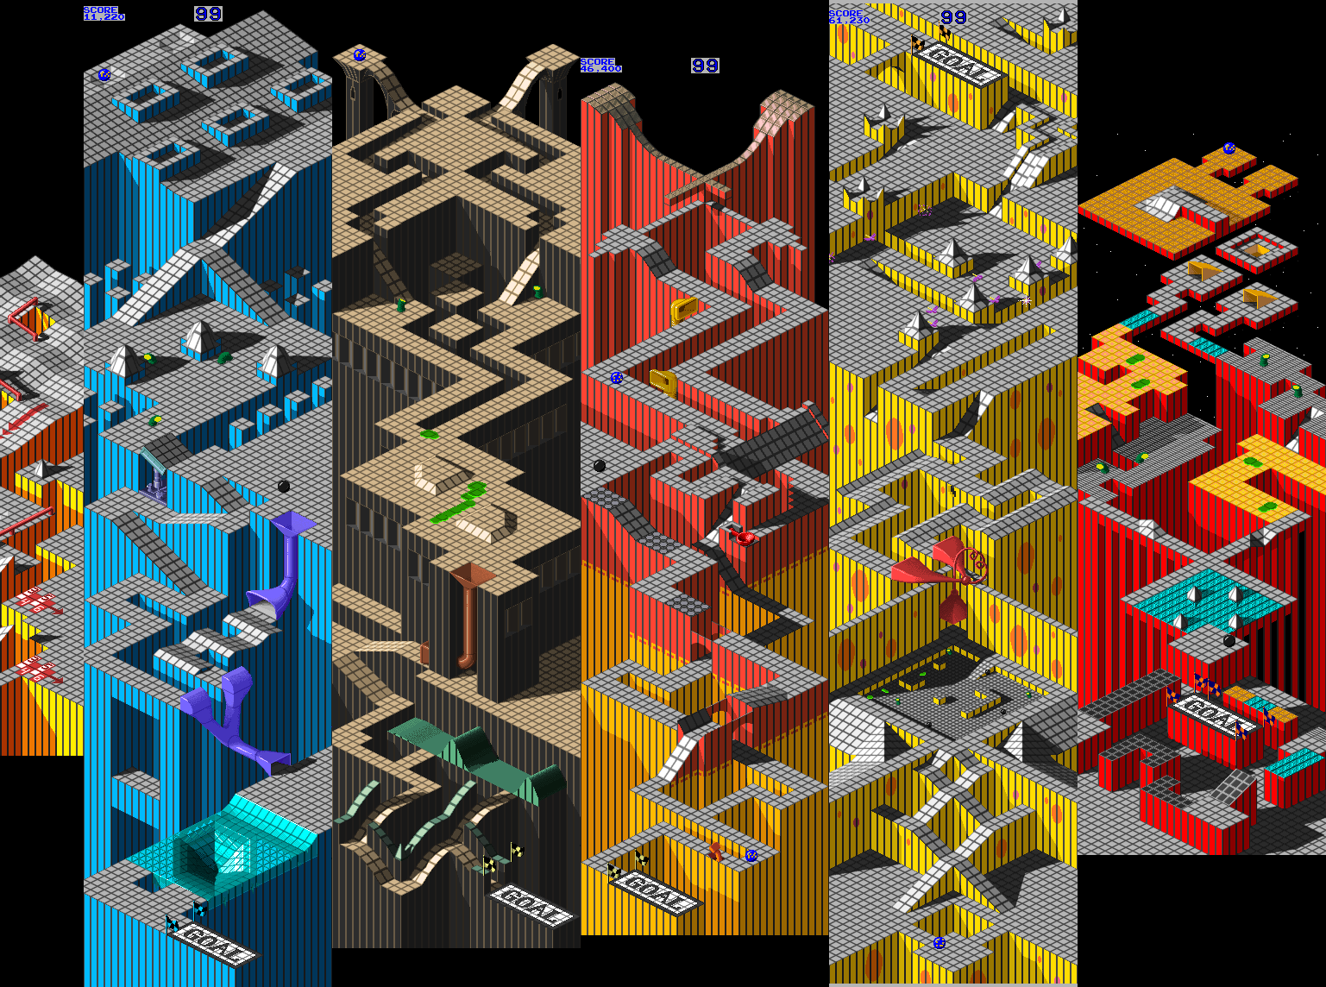
Project Art Style
Bright Backgrounds
Contrast with level

Slide 5
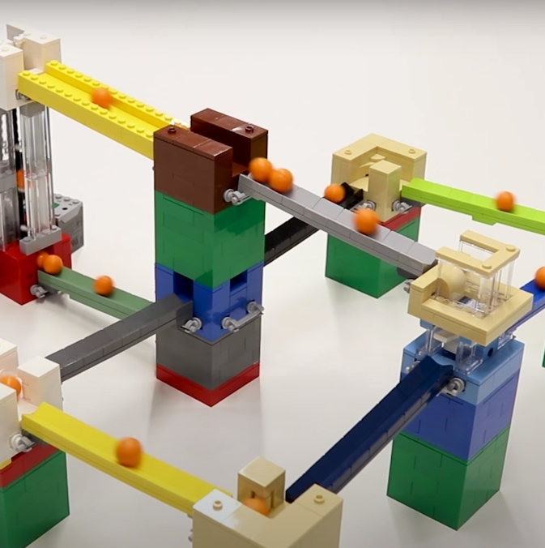
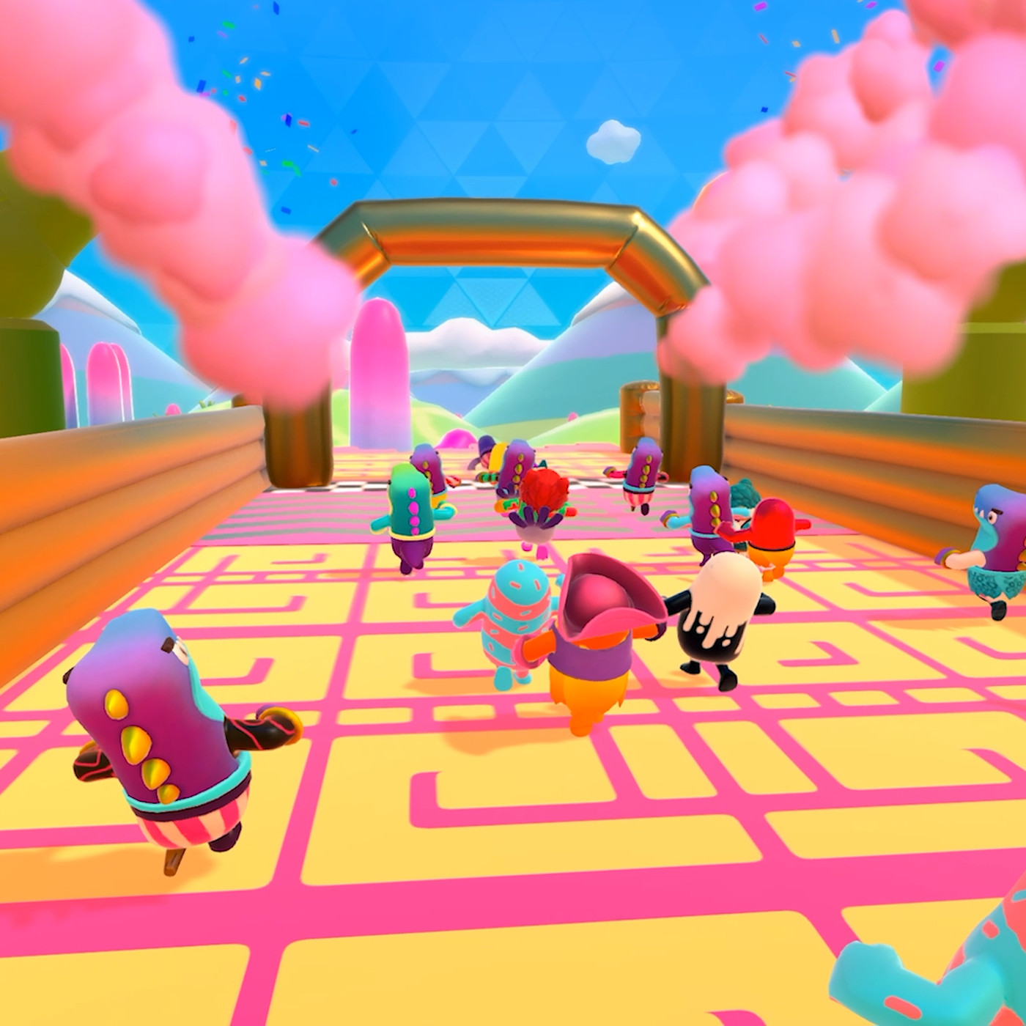
Environment / Atmosphere
Open skies
Small playing space in a large world

Slide 6

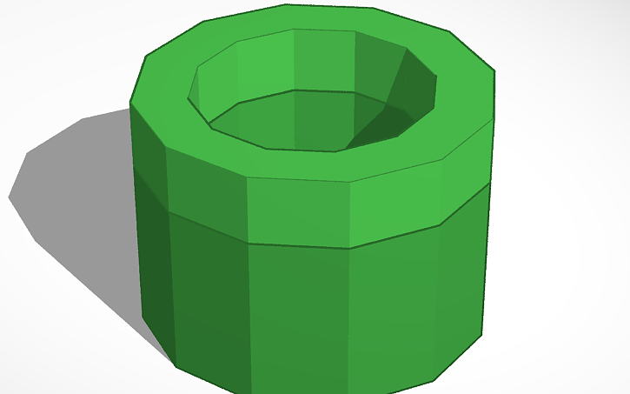

Models
Low poly designs
A Floor Panel (Pre-made)

Slide 7
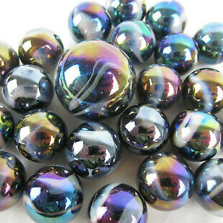
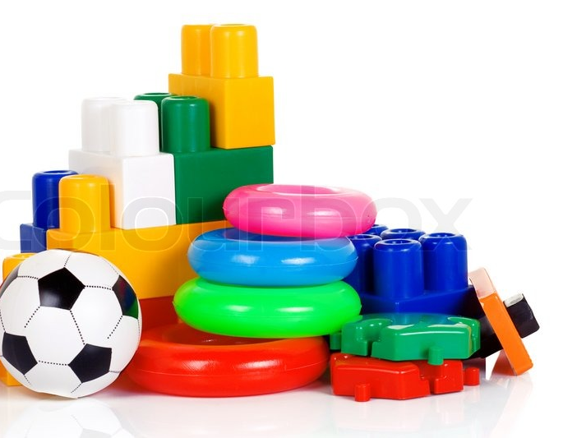
Textures
Plastic toy look
Reflective surfaces

Slide 8
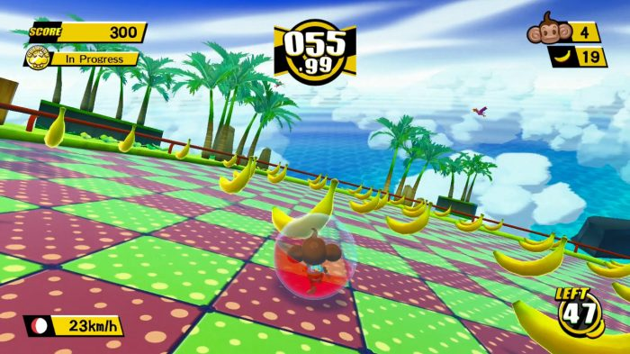
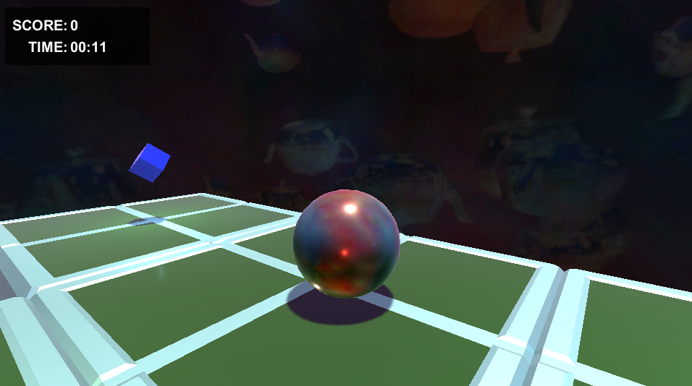
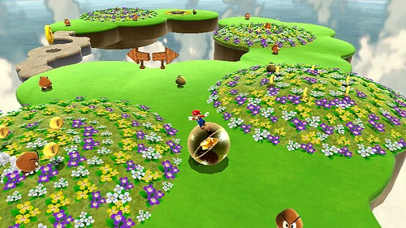
Camera
The game takes place in a 3rd person perspective camera

Slide 9
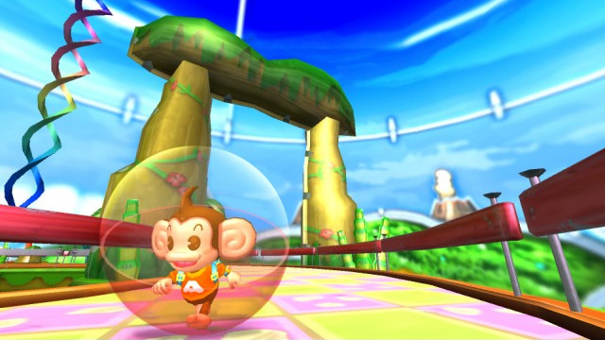
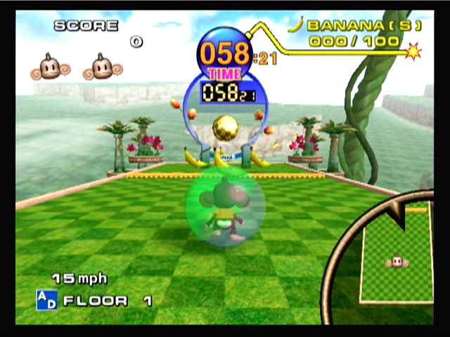

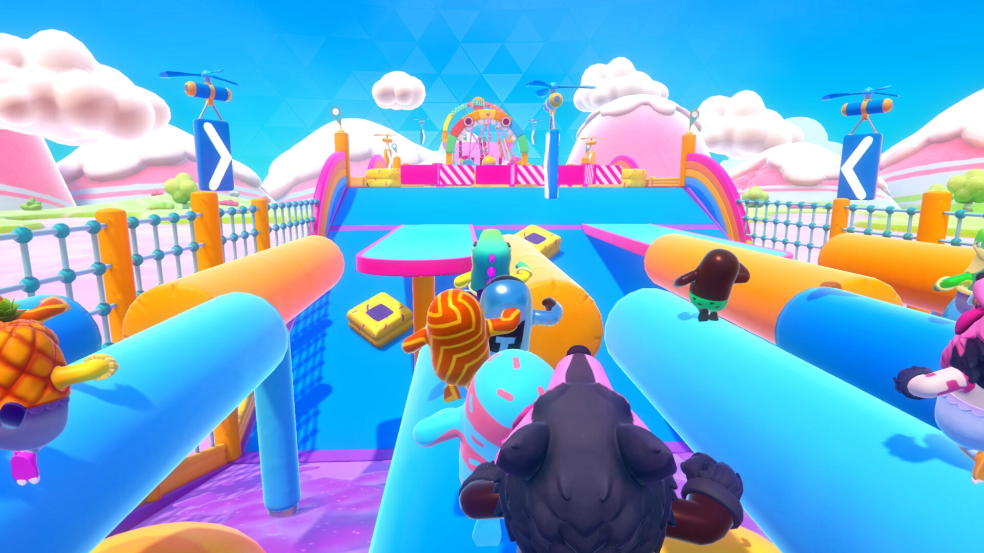
Lighting
One, large overall light source over the whole stage
The collectables emit a light that "breathes"

Slide 10
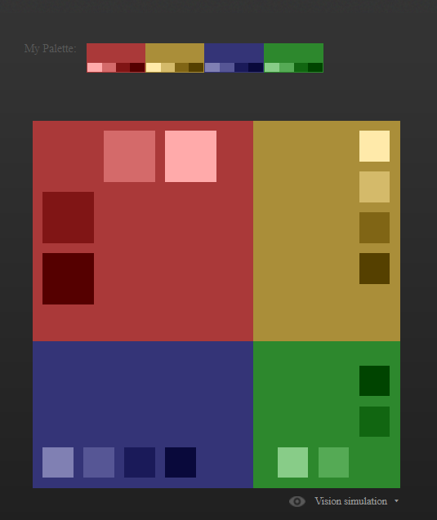

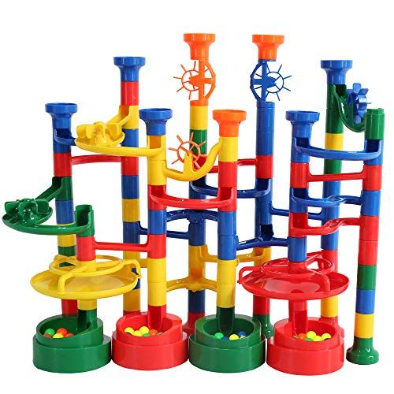
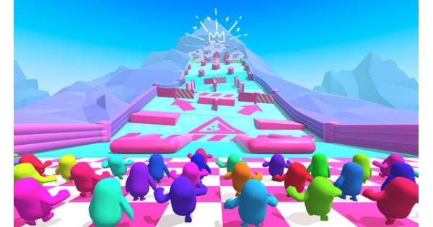
Colour Palette
Pieces of the level:
Red, blue, yellow, green
Sky box

Slide 11
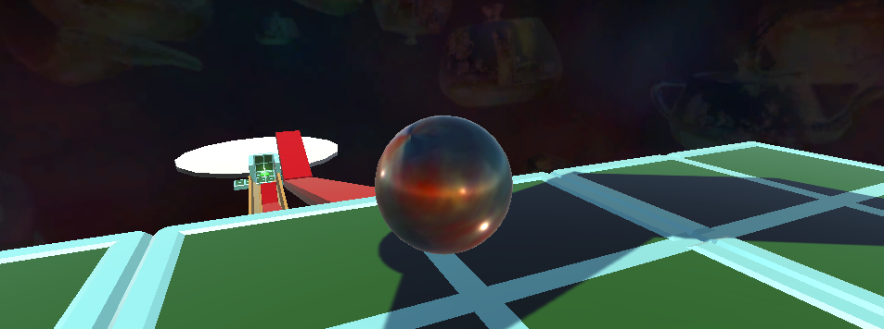
Level of Detail
The entire level can be seen

Slide 12
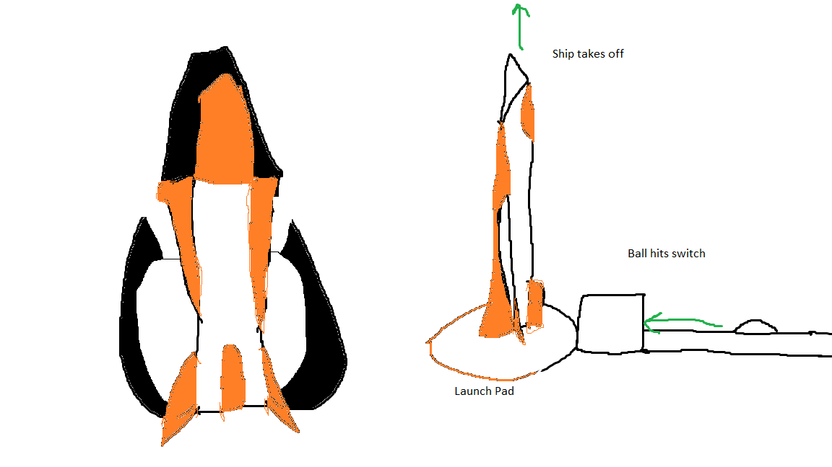
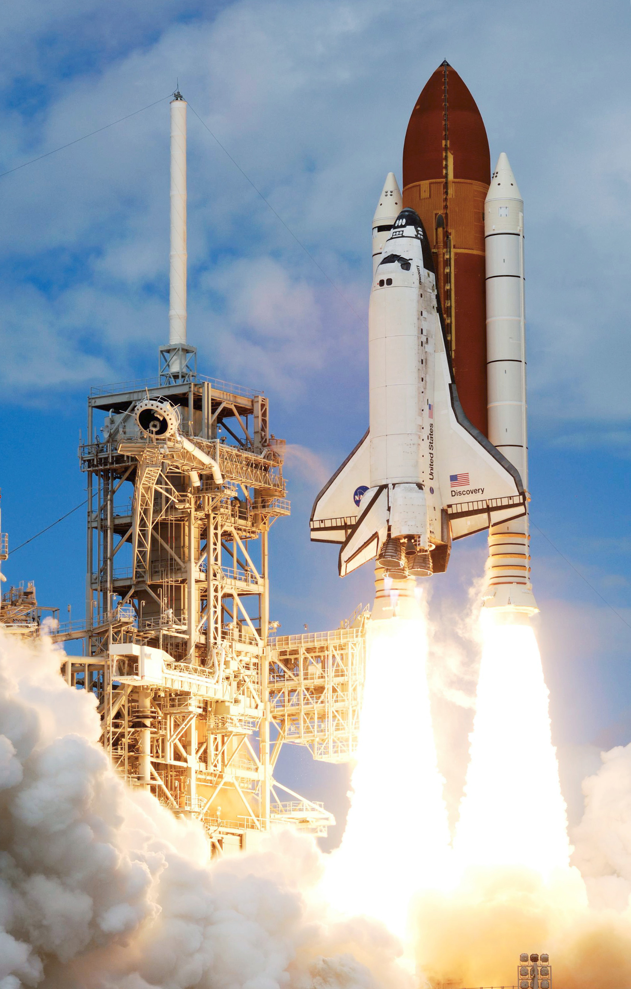
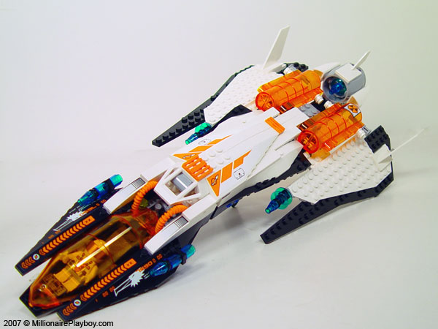
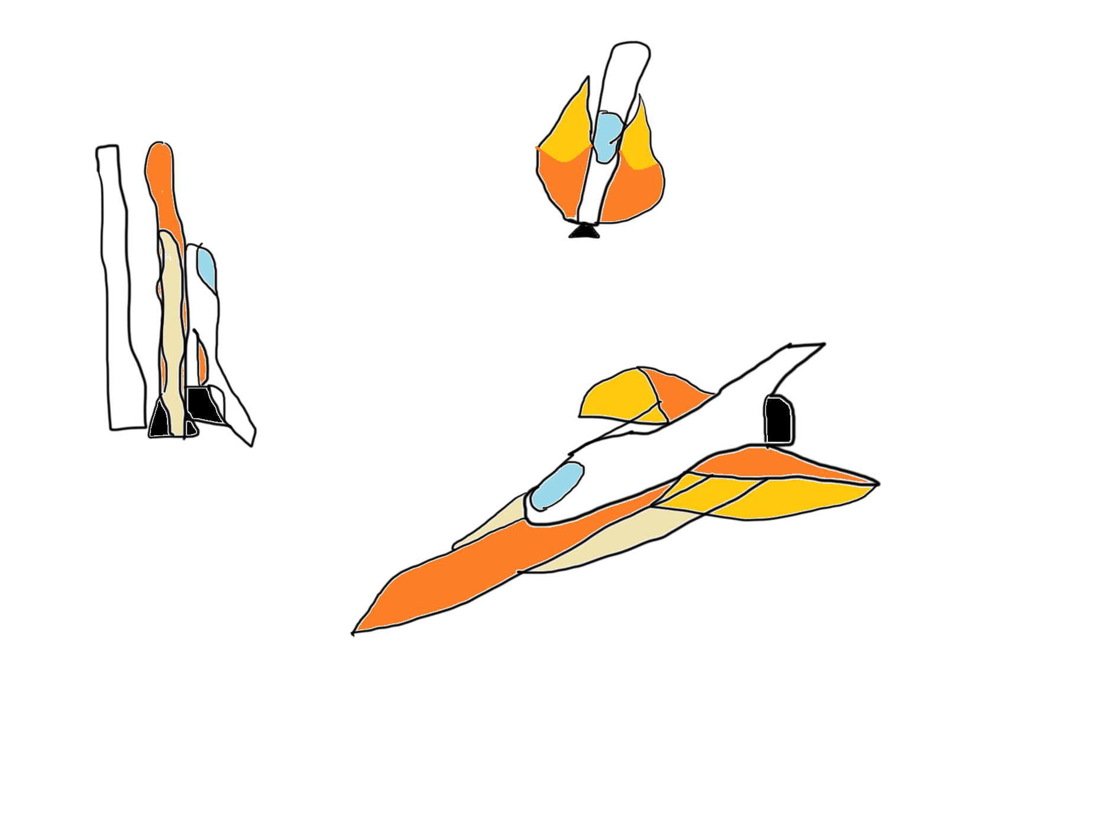
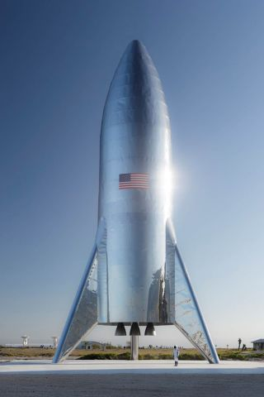
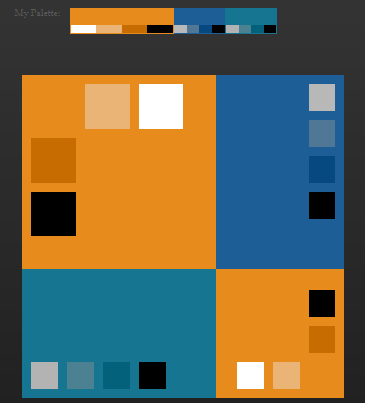
Feature Asset
External Tank
Needs cockpit + wings
Part 1 The Spaceship
Concepts + references

Slide 13
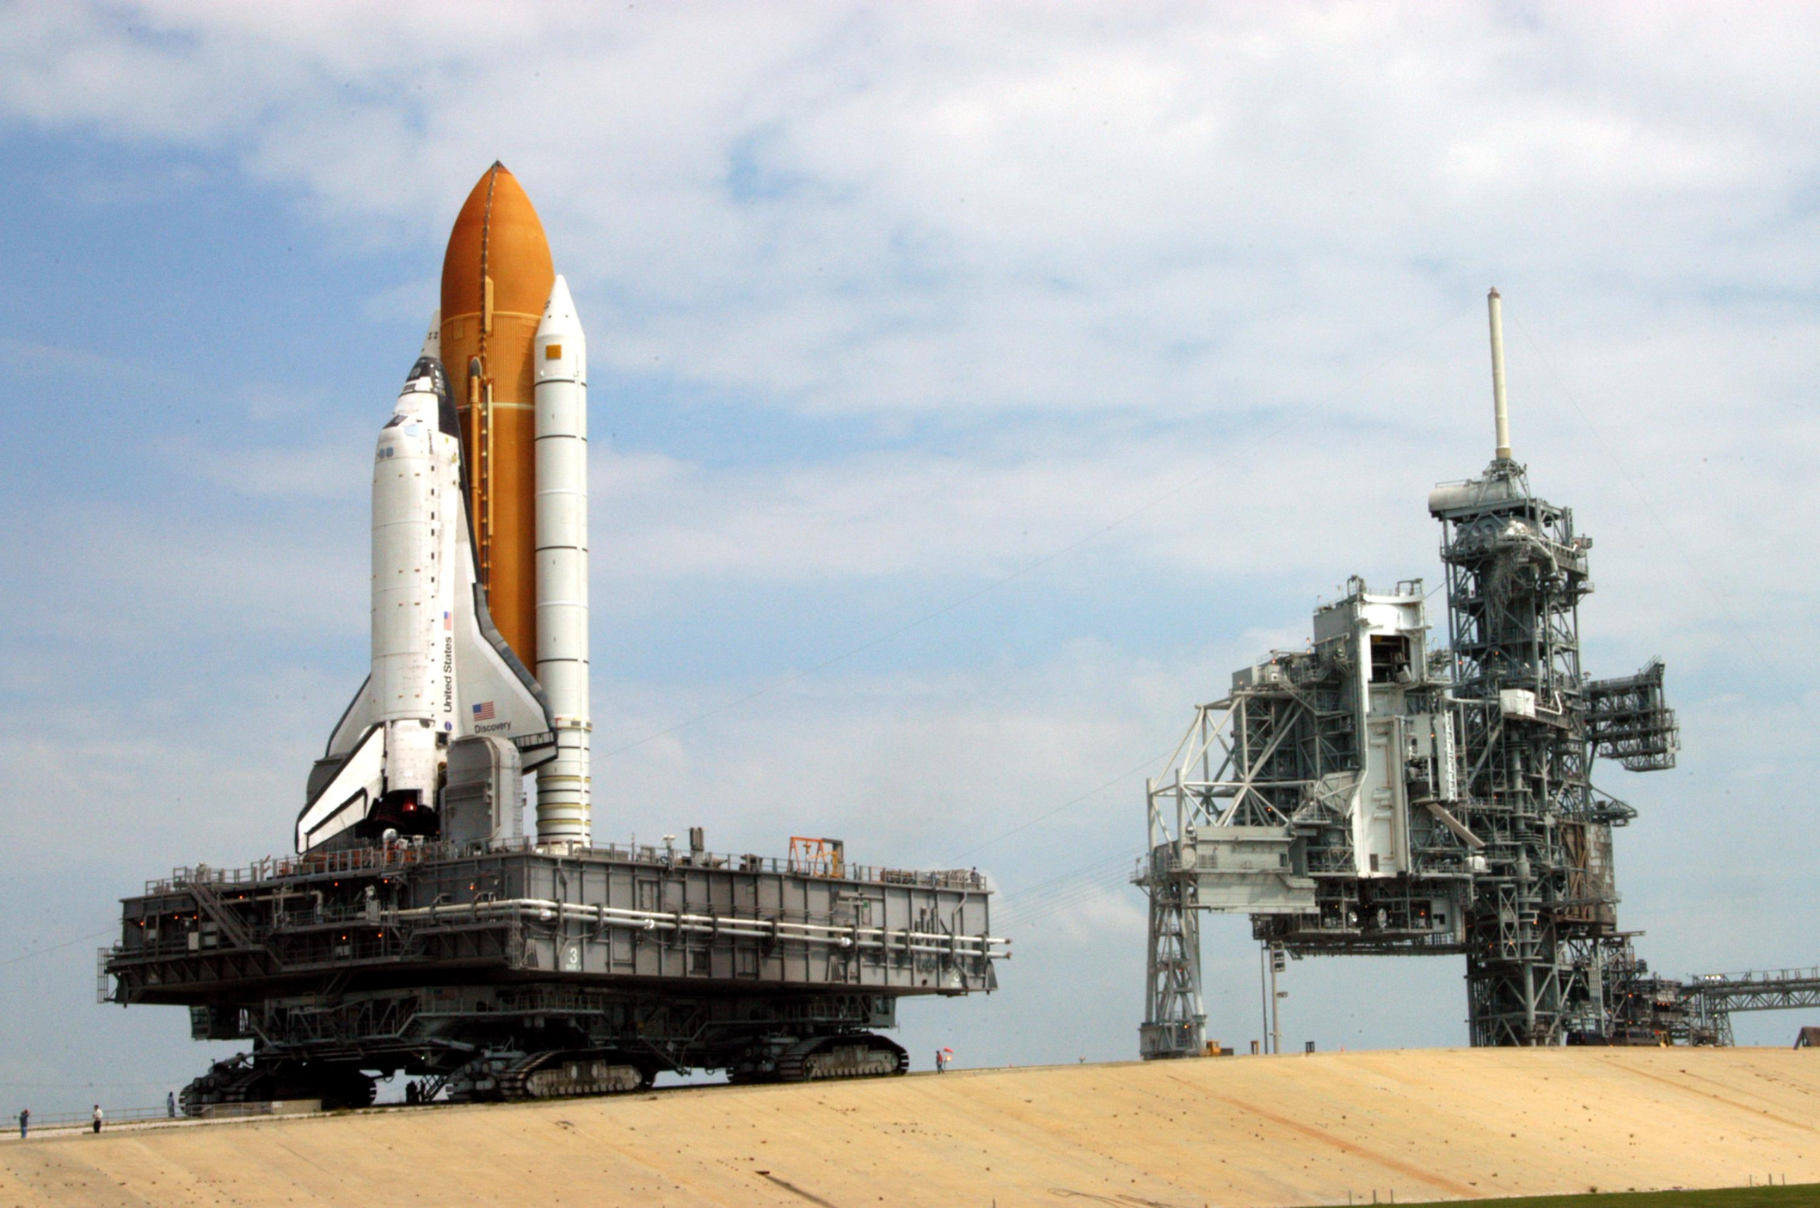
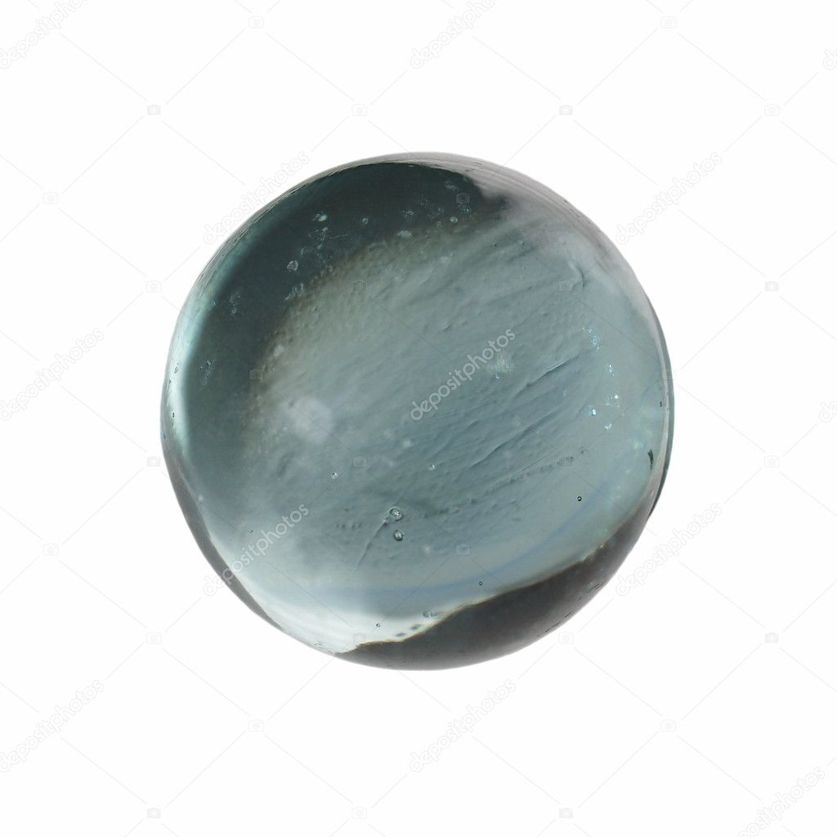


Feature Asset part 2 Functionality
3
2
1

Slide 14

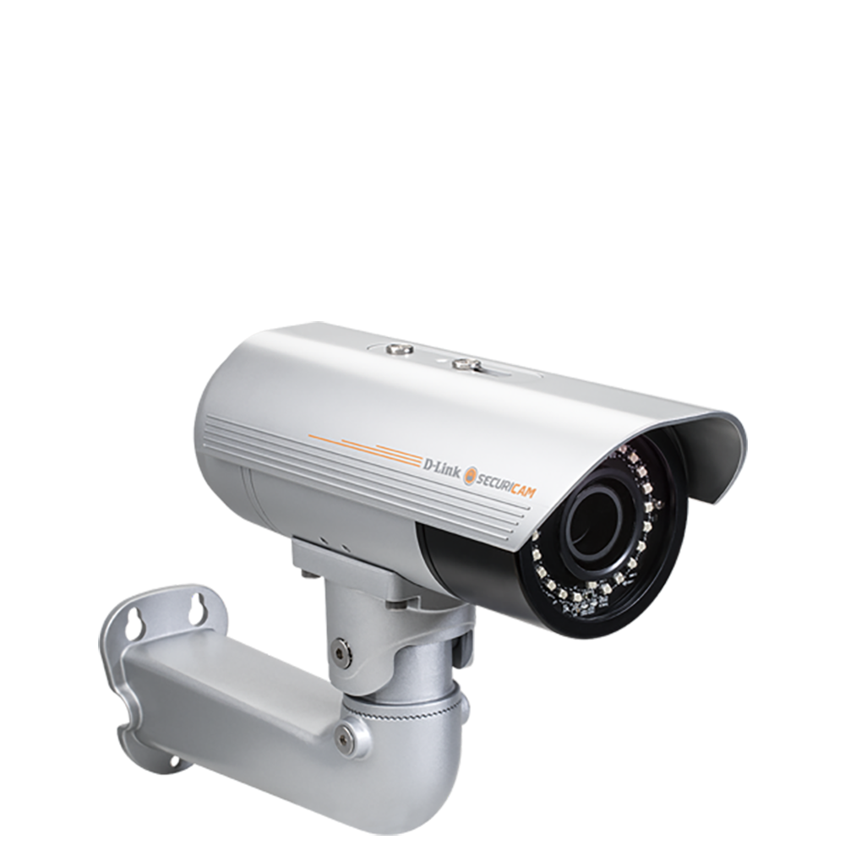

Design Rules
The Feature Asset must be seen by the player
The end goal
The main level will be made of connected pieces
Player
Feature Asset

Slide 15
Art Tools
Photoshop and MS Paint
Drawing and texturing
Maya
3D modelling
Unity

Slide 16
Art Pipeline

Slide 17
Technical Guidelines
Platform: PC
File types and formats:
.mb(Maya)
PNG
Name conventions:
Folder Structure:
Limitations:

